Slide 1
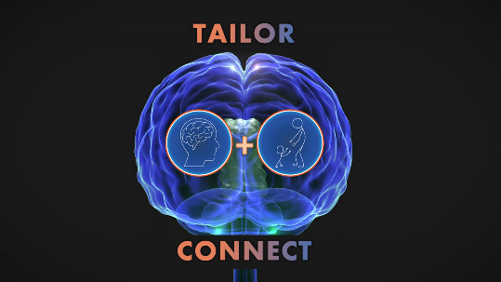




Want more information?
Interested in becoming involved?
Please Contact:
Anna Butler
(Project Co-ordinator)
03 9035 7354
anna.butler@latrobe.edu.au
Brendon Haslam
(Clinical Lead)
b.haslam@latrobe.edu.au
Professor Leeanne Carey
(Chief Investigator)
03 9479 5600
l.carey@latrobe.edu.au
Address:
Melbourne Brain Centre – Austin
245 Burgundy Street
Heidelberg VIC 3084
Potential participants should be adults (over 18 years of age) who have had stroke between three and eighteen months ago.
Participants will receive two programs (six weeks each) of upper limb therapy, that can be delivered remotely to you in your own home.
Participants in the study will be asked to attend Melbourne Brain Centre (Austin) 7-8 times over a period of twelve months.
If you are interested and would like further information, please contact the TAILOR & CONNECT Centre on:
03 9035 7354
anna.butler@latrobe.edu.au
This study has been approved by the Austin Health Human Research Ethics Committee Reference Number HREC/
Project Title:
Staying connected: personalising stroke recovery and rehabilitation through new technologies for people with stroke living at home
Short Title: TAILOR & CONNECT
Information pamphlet for clinicians - Master
Version Number: 1.1 Version Date: 28 August 2022
Austin Health Local Governance v1.1 1

Slide 2

Want more information?
What does participating in TAILOR & CONNECT involve?
Obtaining background information about your stroke and how it affects your daily activities
Asking you about important activities that you would like therapy to focus on
Assessment of your hand and arm function using clinical tests
Participating in two programs of therapy (six weeks each) that can be delivered remotely via telehealth in your own home
Who can be involved?
Anyone who:
Has experienced a stroke between 3-18 months ago
Is 18 years of age or above
Have specific goals to work on
Who provides the therapy?
An experienced Occupational Therapist of Physiotherapist – otherwise called a Research Therapist
What does training involve?
You will receive two programs of upper limb therapy that go for six weeks each. Therapy can be delivered remotely through telehealth, directed by the Research Therapist. Any equipment you may need for therapy will be provided. You may choose to have someone you know (a “Therapy Buddy”) to help you with therapy if you wish.
How often are the sessions?
Each program of therapy consists of approximately 10 therapy sessions over six weeks
The TAILOR & CONNECT Therapy Centres have been established through a partnership between La Trobe University, The Florey Institute of Neuroscience and Mental Health, and Austin Health, with the support of the National Health and Medical Research Council.
The TAILOR & CONNECT Therapy Centre is recruiting people with stroke who have identified activity goals that they would like to focus on achieving through receiving evidence-based upper limb therapy, that can be delivered remotely to them in their own home.
@NeuroRehabSci

